Slide 1

PROJECT GUIDE: Mr. S. Sumahasan Asst. Professor, Department of CSE, GVPCEW
NODE LEVEL POWER AWARE SECURITY ALGORITHMS FOR CLOUD ASSISTED-IoT
PROJECT BATCH:A4
PROJECT MEMBERS:
Gandi Dhanusha (19JG1A0539)
Anjali Kumari (19JG1A0503)
Dantuluri Durga Bhavani (19JG1A0528)
A N L S Prasanna (20JG5A0501)
Department of Computer Science and Engineering
GAYATRI VIDYA PARISHAD COLLEGE OF ENGINEERING FOR WOMEN
[Approved by AICTE NEW DELHI, Affiliated to JNTUK Kakinada]
[Accredited by National Board of Accreditation(NBA) for B.Tech. CSE, ECE & IT – valid from 2019-22 and 2022-25]
[Accredited by National Assessment and Accreditation Council (NAAC) with A Grade – valid from 2022-27]
Kommadi, Madhurawada, Visakhapatnam – 530048
Academic Batch : 2019 – 2023

Slide 2
PRESENTATION OUTLINE
ATTENDANCE
ABSTRACT
PROBLEM DEFINITION
LITERATURE SURVEY
EXISTING SYSTEM
PROPOSED SYSTEM
METHODOLOGY
MODULE EXPLANATION
CONCLUSION
REFERENCES
LIMITATIONS OF EXISTING SYSTEM
ARCHITECTURE DIAGRAM

Slide 3
ABSTRACT
The Internet of Things, which is the fastest-growing technology, will advance in defense, agriculture and medical electronics as well. IoT is now faced with new security issues for data mutuality between two parties as a result of the cloud's influence, which are novel in this study and have not yet been resolved by conventional methods. In order to ensure data security when collecting, storing, and accessing IoT data via the cloud while taking into consideration the ongoing rise in users, this work undertakes a methodical analysis using a secure cloud assisted IoT data management strategy. A node-level power-aware security mechanism is used in the proposed system. As a result, a secure IoT using our technology might withstand most data confidentiality threats from both insiders and outsiders of the IoT. Lightweight security methods for low-power IoT devices with smaller key sizes, lower power consumption, and lower memory and transmission capacity reserve are used to achieve security.
Key words: IoT, Cloud-assisted IoT, Confidentiality, Security Challenges, Node level security algorithm, Attack.

Slide 4
PROBLEM DEFINITION
According to the WHO, CVD (Cardiovascular disease) kills 17.9 million people worldwide, accounting for 31% of all deaths. More than four out of five CVD deaths are due to heart attacks and strokes, and one third of these deaths occur prematurely in people under 70 years of age. Therefore, a method to prevent or assist in the reduction of human life losses. Heat stroke can swiftly harm your brain, heart, kidneys, and muscles if left untreated. The longer you wait to get treatment, the more severe the damage will be, increasing your risk of developing major complications or passing away. The IoT ecosystem has significant challenges related to secure communication, including data integrity and data confidentially in the current trends in cloud-based IOT. To address the security challenges and operate with low-powered, compact devices at the end point (Node) level in a Cloud-based IoT ecosystem, there is a significant need for node-level power-aware security algorithms. Once the data is stored on the cloud, only then is cryptography employed. However, while the raw data is being sent from the node to the cloud, data breaches can occur and there is a possibility of Man-in-the-Middle attack(MiTM).

Slide 5
LITERATURE SURVEY
Authors Names : Rajesh, Sreeja & Paul, Varghese & Menon, Varun & Khosravi , Mohammad.
Title : A Secure and efficient Lightweight Symmetric Encryption Algorithm.
Conference/Journal name :Algorithm for transfer and text files between Embedded IoT.
Page No : 293.
Authors Names : Koblitz , Neal.
Title : Elliptic curve cryptosystems.
Conference/Journal name : Mathematics of Computation.
Page No : 203-209.

Slide 6
LITERATURE SURVEY Contd..
Authors Names : J. A. Stankovic
Title : Research Directions for the Internet of Things
Conference/Journal name : IEEE Internet of Things Journal
Page No : 3-9
Authors Names : R. K. Kodali and A. Naikoti
Title : ECDH based security model for IoT using ESP8266
Conference/Journal name : 2016 International Conference on Control
Page No : 629-633

Slide 7
LITERATURE SURVEY Contd..
Title | Approach and Outcome
A Secure and efficient Lightweight Symmetric Encryption Algorithm. | Lightweight cryptography is often used for embedded systems where a larger CPU comes at a premium. That used to include telephones , IoT devices , etc.
Elliptic curve cryptosystems. | ECC generates security between key pairs for public key encryption by using the mathematics of elliptic curves.
Research Directions for the Internet of Things. | In recent years, the IoT has drawn significant attention as it can solve difficult problems. However, the heterogeneity of devices and the large scale networks expose the IoT to many challenges that must be addressed; otherwise, the systems performance will deteriorate.
ECDH based security model for IoT using ESP8266. | To achieve the task of connecting devices ESP8266 is used which provides embedded Wi-Fi capabilities at lowest cost with good functionality and low computing power.

Slide 8
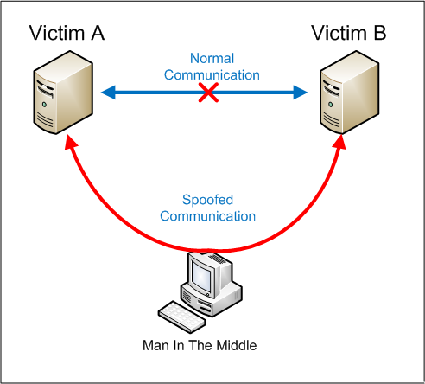
EXISTING SYSTEM
The security is provided to the data in the cloud when data is transferred from one point to the other.
Data is encrypted using various symmetric cryptographic algorithms.
The encryption is performed only at the cloud level.
This can lead to security breaches while uploading the data to the cloud.
Also, the power consumption is high in the existing system.

Slide 9
LIMITATIONS OF EXISTING SYSTEM
The consumption of power in the existing system is high and so it is not power-aware.
Security to the data is provided after reaching the cloud leading to Man-in-the-middle Attack.
Even a small mistake in configuration or coding may result in a diminishment of some or all of the cryptographic security.

Slide 10
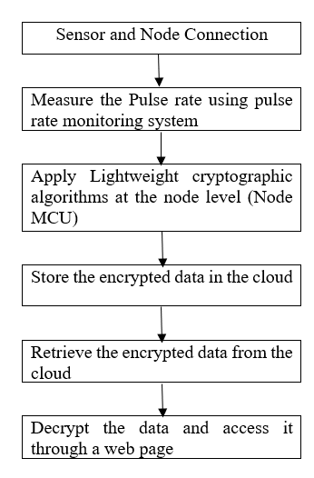
PROPOSED SYSTEM

Slide 11
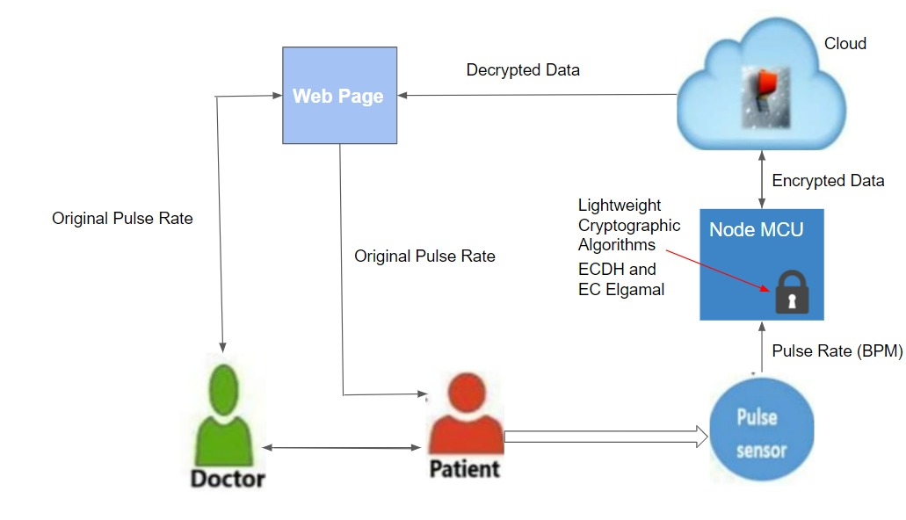
PROPOSED SYSTEM Contd..
ARCHITECTURE DIAGRAM

Slide 12
METHODOLOGY
A node-level implementation of the public key cryptosystem, Elliptic Curve Cryptography, which was considered as the efficient algorithm based on research, is being implemented to achieve efficient security for low power IoT devices, and the work to implement the node level power-aware security algorithm has been divided into four modules:
1. Designing a heartbeat monitoring system.
2. Providing security at node level.
3. Uploading encrypted data into cloud.
4. Accessing the data through webpage.

Slide 13
MODULES EXPLANATION
1. Design a Heartbeat monitoring system.
The heart rate sensor is used to gather the patient's heartbeat data, and the Node MCU is used to store the data obtained from the patient.
2. Providing Security at the Node Level.
The data should be encrypted in the node itself after the heart rate sensor is linked to the Node MCU and the patient's heart rate is detected.
The Elliptic curve Diffie Hellman algorithm is utilized for this.
Elliptic-curve Diffie–Hellman (ECDH) is a key agreement mechanism that uses an elliptic curve public-private key pair to allow two parties to construct a shared secret via an unsecured channel.
This shared secret can serve as a key or be used to produce a new one. Comprehending the principles of the Elliptic Curve is necessary for understanding Elliptic Curve Cryptography.

Slide 14
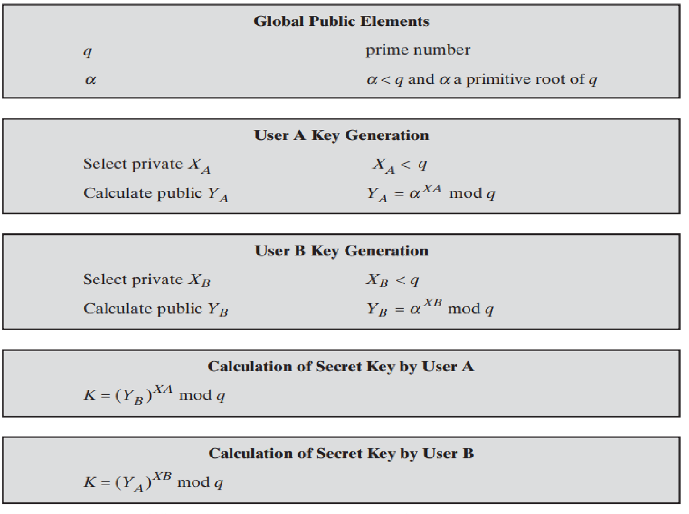
MODULES EXPLANATION Contd..
ECDH ALGORITHM
ECDH (Elliptic Curve Diffie-Hellman) is a variant of the Diffie-Hellman algorithm for elliptic curves.
It is actually a key-agreement protocol, more than an encryption algorithm. This basically means that ECDH defines (to some extent) how keys should be generated and exchanged between parties. How to actually encrypt data using such keys is up to us.
The problem it solves is the following: two parties (the usual Alice and Bob) want to exchange information securely, so that a third party (the Man In the Middle) may intercept them, but may not decode them.

Slide 15
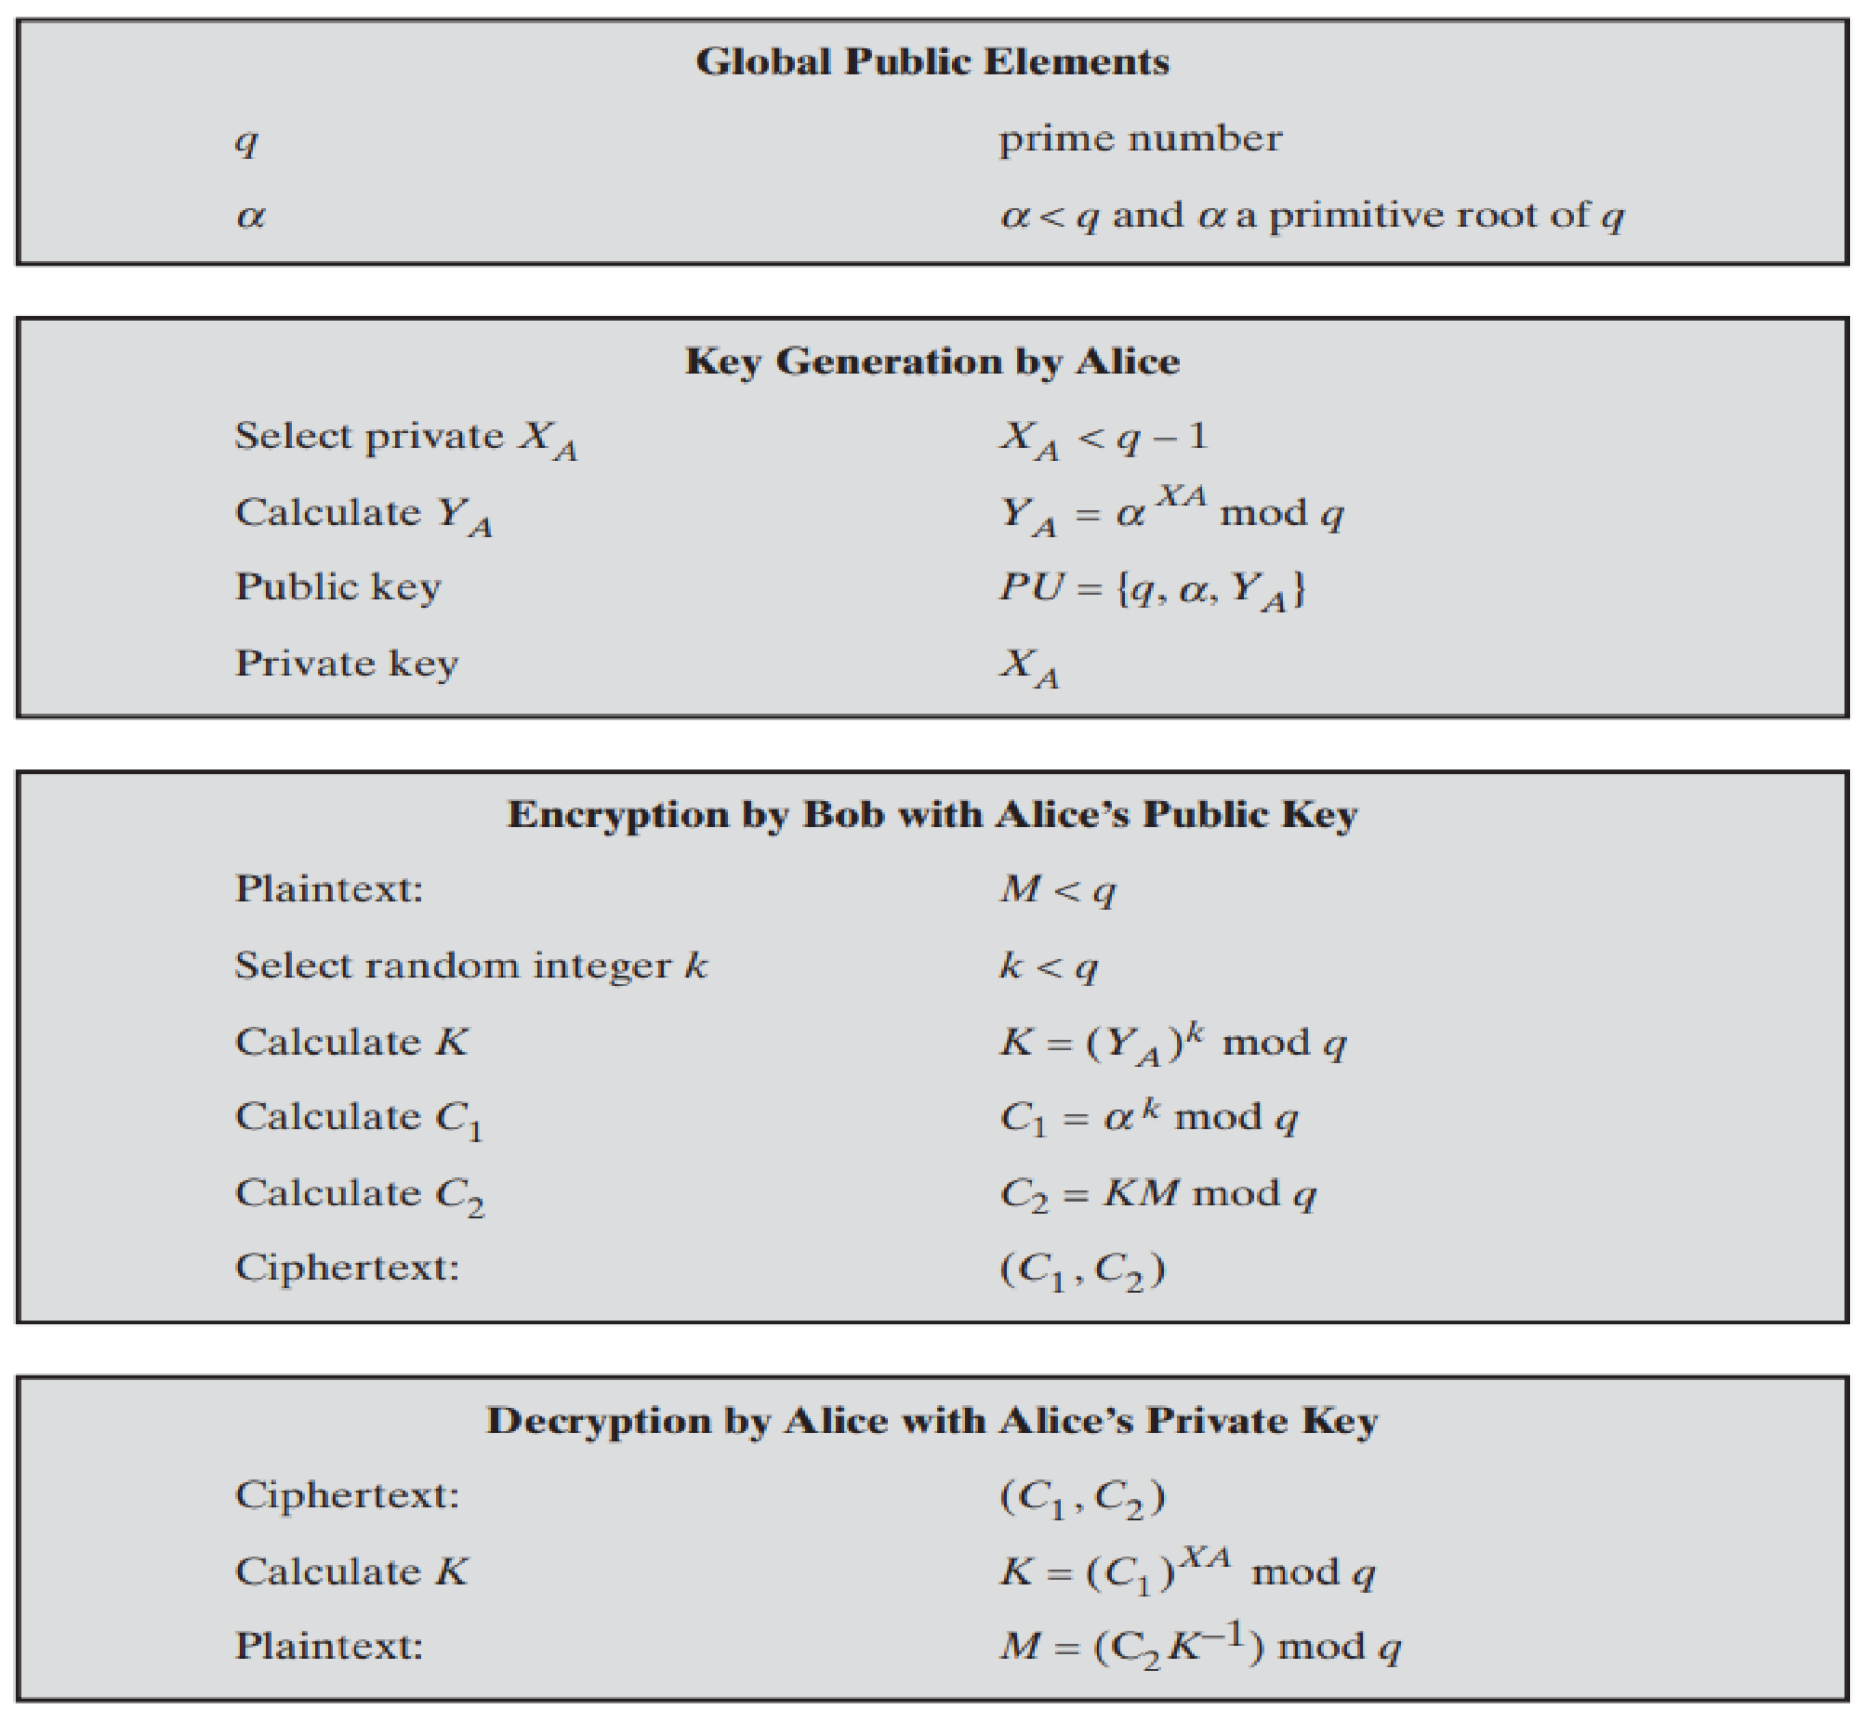

MODULES EXPLANATION Contd..
EC ELGAMAL ALGORITHM
EC ElGamal is the short form for Elliptic Curve ElGamal which is one of the algorithms present in the elliptic curve cryptosystem.
We often use elliptic curves for public key cryptography tasks such as key exchange and digital signature tasks. Because these curves serve faster implementations than other trusted algorithms such as Diffie Hellman or RSA(Rivest-Shamir-Adleman).
Rarely, we can adapt elliptic curves for symmetric key encryption tasks. This idea is mainly based on ElGamal encryption schema and elliptic curves.
We will create a python implementation of this concept. All points on the elliptic curve can be mapped directly to an ASCII value.
Koblitz represents message as a point or a set of points on an elliptic curve.
${ y}^{2}$ mod p= ${ x}^{3}$+ $ax$+b mod p

Slide 16
MODULES EXPLANATION Contd..
3. Uploading encrypted data to cloud.
The encrypted data is to be kept in the cloud after the Heart Rate is measured and encrypted using the ECDH technique.
A cloud computing technique in which data is kept on the Internet and maintained and operated by a cloud computing provider is known as cloud storage.
4. Accessing data through a Web Page.
A registration page will be available in this module, where the end-user (doctor or patient's relatives) will authenticate and register. Only the registered end-user has access to the patient's information.
In the interface via which the end-user gets the data, the decryption is done using the ECDH method.
The end-user submits a request to the interface, which is received and processed, after which the specific data is decrypted and made available to the end-user via the interface.

Slide 17
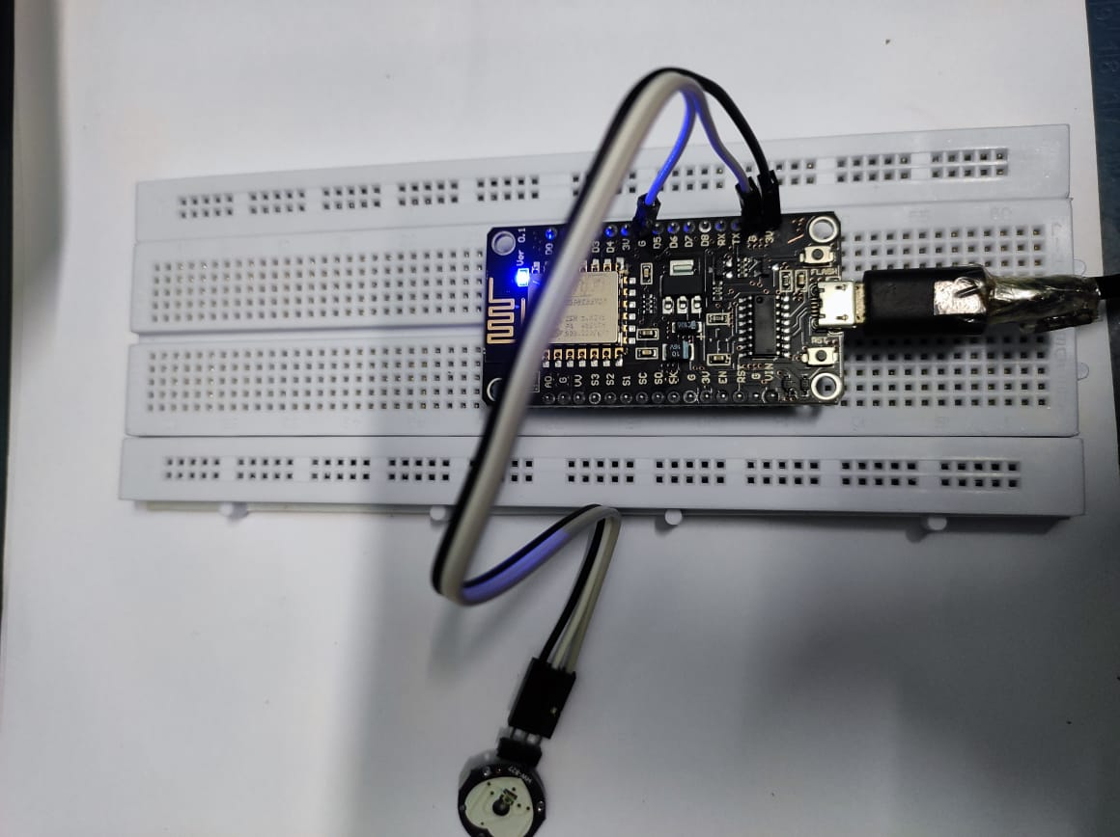
NODE CONNECTION

Slide 18
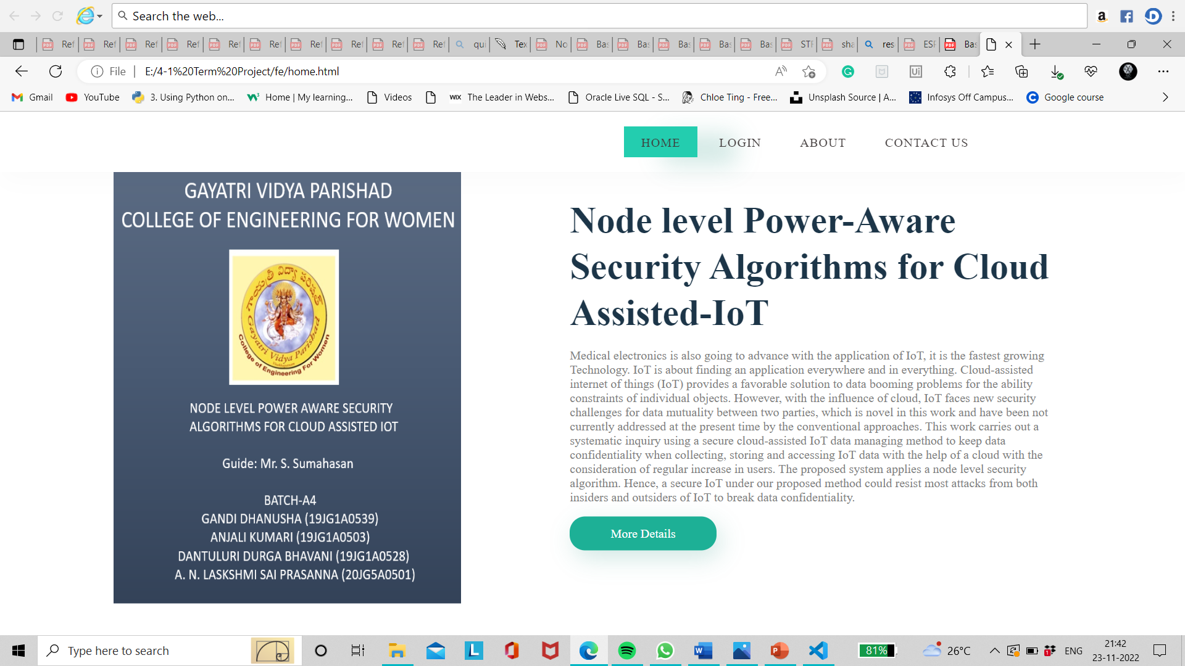

OUTPUT SCREENS

Slide 19


OUTPUT SCREENS

Slide 20
.
CONCLUSION
This approach helps to secure users data from malicious attacks and gives security to the fullest.
Only authorized users can access the data.
The numerous benefits provided by encryption have driven many large multi-level organizations to transfer their data based on it.

Slide 21
REFERENCES
[1] R. K. Kodali and A. Naikoti, "ECDH based security model for IoT using ESP8266," 2016 International Conference on Control, Instrumentation, Communication and Computational Technologies (ICCICCT), 2016, b pp. 629-633, doi: 10.1109/ICCICCT.2016.7988026.
[2] Goyal, Tarun & Sahula, Vineet. (2016). Lightweight security algorithm for low power loT devices. 1725 1729. 10.1109/ICACCI.2016.7732296.
[3] Koblitz, Neal. "Elliptic curve cryptosystems. "Mathematics of Computation 48 (1987): 203-209.
[4] Rajesh, Sreeja & Paul, Varghese & Menon, Varun & Khosravi, Mohammad. (2019). A Secure and Efficient Lightweight Symmetric Encryption Scheme for Transfer of Text Files between Embedded IoT Devices. Symmetry. 11. 293. 10.3390/sym11020293.
[5] V. S. Mahalle and A. K. Shahade, "Enhancing the data security in Cloud by implementing hybrid (Rsa & Aes) encryption algorithm," 2014 International Conference on Power, Automation and Communication (INPAC), 2014,pp.146-149.

Slide 22
THANK YOU!

